Slide 1
Notes:
.

Slide 2
Lesson #

Slide 3
2023 | Q1 | Exodus 1-13 | Ben
 | Q2 | Exodus 14-24 | Chase
 | Q3 | Exodus 25-40 | Orin
1
the introduction
Notes:
2022 Genesis
Appreciate the elders approach and time given

Slide 4
Timeline
Adam
& Eve
Moses
Flood
Jesus
Us
4000 BC
3000
2500
2000
1500
1000 BC
500
0
1000 AD
2000
David
Abraham
#
the topic
Notes:
Remember just ballpark for easy memory

Slide 5
Timeline: Moses
Moses kills Egyptian
Plagues & Exodus
Death
Birth
1550 BC
1525
1500
1475
1450
1425
1400 BC
Pharaoh’s
House
40 years
Midian Shepherding
40 years
Wilderness Wandering
40 years
2
the hebrews
Notes:
1525 Birth of Moses & adopted by princess
1485 Moses Murdered Egyptian
1445 Plagues & Exodus
1405 Moses death
Would have written Genesis, exodus, Leviticus, numbers and Deuteronomy

Slide 6
Read Exodus
2
the hebrews
Notes:
.

Slide 7
Question?
Answer
#
the topic
Notes:
Connected Moses to which God this was
The God of the Hebrews
The God of the Israelites
The god of the patriarchs
Matthew 22:31-32 — But Jesus answered and said to them, “You are mistaken, not understanding the Scriptures nor the power of God. For in the resurrection they neither marry nor are given in marriage, but are like angels in heaven. 31But regarding the resurrection of the dead, have you not read what was spoken to you by God: ‘I am the God of Abraham, and the God of Isaac, and the God of Jacob’? He is not the God of the dead but of the living.” When the crowds heard this, they were astonished at His teaching.

Slide 8
Jacob
Leah
Levi
137
Kohath
Jochebed
Gershon
Merari
133
Amram
137
Jochebed
Moses
Aaron
Miriam
120
Zipporah
[Cushite]
Elisheba
Gershom
Eliezer
Nadab
Abihu
Eleazar
Ithamar
3
the moses
Notes:
This is the 400/430 year gap issue
This lineage is repeated many times in OT always the same

Slide 9
By faith Moses, when he was born, was hidden for three months by his parents, because they saw that he was a beautiful child; and they were not afraid of the king’s commandment.
11
Hebrews
3
the moses
Notes:
..

Slide 10
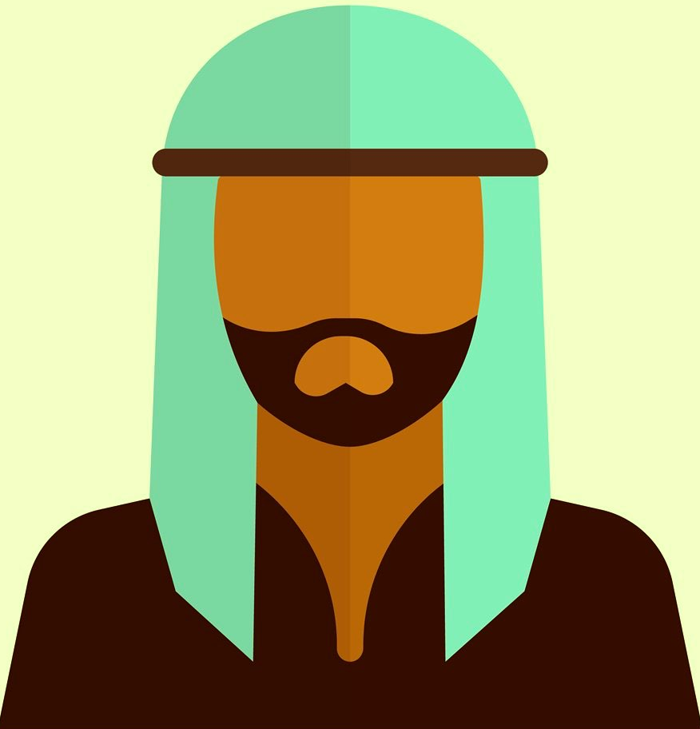
🧑🏾‍🦱
👴🏽
👴🏾
👨🏿
👩🏾
👨🏾
👴🏾
👴🏿
👵🏾
👩🏾‍🦱
8
the start
Notes:
Why in the world introduce this complication? Mose to Aaron to the people?
God calls Abraham a prophet to Melchizedek in Gen 20:7
Jude - calls enoch a prophet
Gen 7 - god calls Aaron a prophet for Moses
God is setting forth a pattern here

